Slide 1
FortiGate Security
Web Filtering
FortiOS 7.2
Notes:
In this lesson, you will learn how to configure web filtering on FortiGate to control web traffic in your network.

Slide 2
Inspection Modes
Web Filtering Basics
Additional Proxy-Based Web Filtering Features
Video Filtering
Best Practices and Troubleshooting
Notes:
In this lesson, you will learn about the topics shown on this slide.

Slide 3
Inspection Modes
Describe FortiGate inspection modes
Review NGFW operation modes
Notes:
After completing this section, you should be able to achieve the objectives shown on this slide.
By demonstrating competence in understanding inspection modes, you will be able to implement the appropriate inspection modes to support the desired security profiles.

Slide 4

Flow-Based Inspection
Per firewall policy setting
Default inspection mode
Uses single-pass direct filter approach (DFA) pattern matching to identify possible attacks or threats
File is scanned on a flow basis as it passes through FortiGate
Requires fewer processing resources
Faster scanning
Client
FortiGate
Server
SYN
Policy & Objects > Firewall Policy
SYN-ACK
ACK
Notes:
Flow-based inspection mode examines the file as it passes through FortiGate, without any buffering. As each packet arrives, it is processed and forwarded without waiting for the complete file or web page. If you are familiar with the TCP flow analysis of Wireshark, then that is essentially what the flow engine sees. Packets are analyzed and forwarded as they are received. Original traffic is not altered. Therefore, advanced features that modify content, such as safe search enforcement, are not supported.
The advantages of flow-based mode are:
The user sees a faster response time for HTTP requests compared to proxy based
There is less chance of a time-out error because of the server at the other end responding slowly
The disadvantages of flow-based mode are:
A number of security features that are available in proxy-based mode are not available in flow-based mode
Fewer actions are available based on the categorization of the website by FortiGuard services

Slide 5

Proxy-Based Inspection
More thorough inspection
Adds latency
  Complete content is scanned
Two TCP connections
  From client to FortiGate acting as proxy server
  From FortiGate to server
Communication is terminated on Layer 4
More resource intensive
Provides a higher level of threat protection
Client
FortiGate
Server
SYN
SYN-ACK
ACK
SYN
SYN-ACK
ACK
Policy & Objects > Firewall Policy
Notes:
Proxy-based scanning refers to transparent proxy. It’s called transparent because, at the IP layer, FortiGate is not the destination address, but FortiGate does intercept the traffic. When proxy-based inspection is enabled, FortiGate buffers traffic and examines it as a whole, before determining an action. Because FortiGate examines the data as a whole, it can examine more points of data than it does when using flow-based inspection.
In TCP connections, the FortiGate proxy generates the SYN-ACK to the client, and completes the three-way handshake with the client, before creating a second, new connection to the server. If the payload is less than the oversize limit, the proxy buffers transmitted files or emails for inspection, before continuing transmission. The proxy analyzes the headers and may change the headers, such as HTTP host and URL, for web filtering. If a security profile decides to block the connection, the proxy can send a replacement message to the client. This adds latency to the overall transmission speed.
Proxy-based inspection is more thorough than flow-based inspection, yielding fewer false positives and negative results.

Slide 6
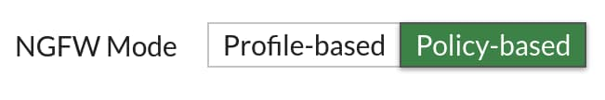
NGFW Mode
Features two modes:
  Profile-based
    Requires application control and web filtering profiles
    Apply the profiles to the policy
    Applicable to proxy-based and flow-based inspection modes
  Policy-based
    Application control and web filtering applied directly to the policy
    Does not require application control and web filtering profiles
    Applicable only to flow-based inspection mode
Antivirus configuration is always profile based, regardless of the NGFW mode selection
Set the NGFW policy-based mode in the system settings of FortiGate or VDOM
System > Settings
Notes:
FortiGate, or the individual VDOM, has two next-generation firewall (NGFW) modes available:
Profile-based mode: Requires administrators to create and use application control and web filter profiles and apply them to a firewall policy. Profile-based mode is applicable to use flow-based or proxy-based inspection mode as per the policy.
Policy-based mode: Administrators can apply application control and web filter configuration directly to a security policy. Flow-based inspection mode is the only applicable process available in policy-based NGFW mode.
Antivirus scanning is available as a security profile that you can apply in a profile-based NGFW mode firewall policy or policy-based NGFW mode security policy.
You can change NGFW mode in the system settings of FortiGate or the individual VDOM. Note that the change will require you to remove all existing policies in either mode.

Slide 7
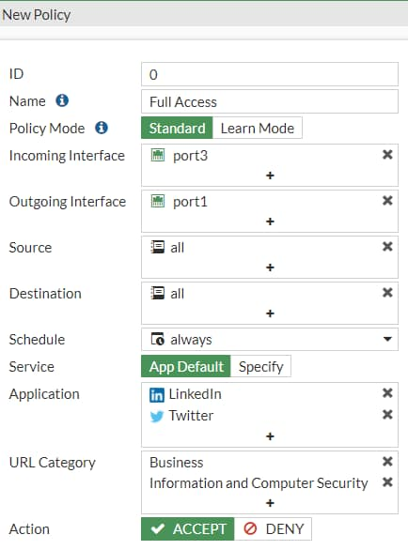
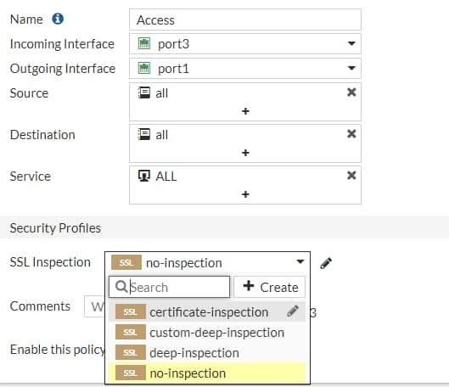
NGFW Mode—Policy Based
Security policy and SSL Inspection & Authentication (consolidated) policy must be configured
Traffic to match SSL Inspection & Authentication policy first
  If allowed, then to inspect applications, URL categories and groups configured on security policy
  Inspect traffic with additional security profiles, if enabled, such as AV, IPS, and file filter
  Can use users and groups if authentication is required
Available actions in security policy: ACCEPT or DENY
SSL inspection profile to be selected in the consolidated policy
Policy & Objects > Security Policy
Policy & Objects > SSL Inspection & Authentication
Notes:
If you configured FortiGate to use NGFW policy-based mode or created a VDOM specifically to provide NGFW policy-based mode, you must configure a few policies to allow traffic.
SSL Inspection & Authentication (consolidated) policy: This policy allows traffic from a specific user or user group to match the criteria specified within the consolidated policy, and inspect SSL traffic using the SSL inspection profile selected. FortiGate can either accept or deny the traffic.
Security policy: If the traffic is allowed according to the consolidated policy, FortiGate then processes it based on the security policy to analyze additional criteria, such as URL categories, groups for web filtering, and application control. Also, if enabled, the security policy further inspects traffic using security profiles such as AV, IPS, and file filter.

Slide 8

How does NGFW policy-based mode differ from profile-based mode?
  Policy-based flow inspection supports web profile overrides.
  Policy-based flow inspection defines URL filters directly in the firewall policy.
Which statement about proxy-based web filtering is true?
  It requires more resources than flow-based
  It transparently analyzes the TCP flow of the traffic

Slide 9
Inspection Modes
Web Filtering Basics
Additional Proxy-Based Web Filtering Features
Video Filtering
Best Practices and Troubleshooting
Notes:
Good job! You now understand inspection modes.
Now, you will learn about web filtering basics.

Slide 10
Web Filtering Basics
Describe web filter profiles
Work with web filter categories
Notes:
After completing this section, you should be able to achieve the objectives shown on this slide.
By demonstrating competence in web filtering basics, you will be able to describe web filter profiles and use FortiGuard web filter profiles.

Slide 11
Why Apply Web Filtering?
Mitigate the negative effects of inappropriate web content
Preserve employee productivity
Prevent network congestion
Prevent data loss and exposure of confidential information
Decrease exposure to web-based threats
Prevent copyright infringement
Prevent viewing of inappropriate or offensive material
Notes:
Web filtering helps to control, or track, the websites that people visit. There are many reasons why network administrators apply web filtering, including to:
Preserve employee productivity
Prevent network congestion, where valuable bandwidth is used for non-business purposes
Prevent loss or exposure of confidential information
Decrease exposure to web-based threats
Limit legal liability when employees access or download inappropriate or offensive material
Prevent copyright infringement caused by employees downloading or distributing copyrighted materials
Prevent children from viewing inappropriate material

Slide 12
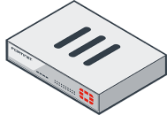

When Does Web Filtering Activate?
www.acme.com
Filtering is based on request
Web Filter:
  HTTP GET
DNS Request
DNS Response
SYN
SYN/ACK
ACK
HTTP GET
Web Filter
Notes:
(slide contains animation)
The example on this slide shows the flow of an HTTP filter process.
FortiGate looks for the HTTP GET request to collect URL information and perform web filtering.
So, as shown, in HTTP the domain name and URL are separate pieces. The domain name might look like the following in the header: Host: www.acme.com, and the URL might look like the following in the header: /index.php?login=true.
If you filter by domain, sometimes it blocks too much. For example, the blogs on tumblr.com are considered different content, because of all the different authors. In that case, you can be more specific, and block by the URL part, tumblr.com/hacking, for example.

Slide 13
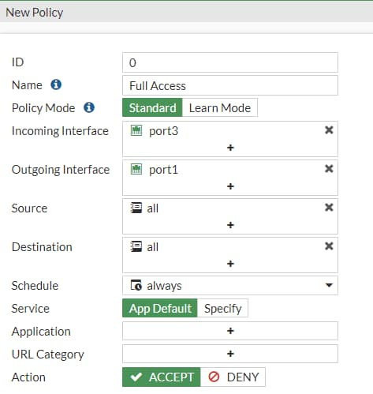
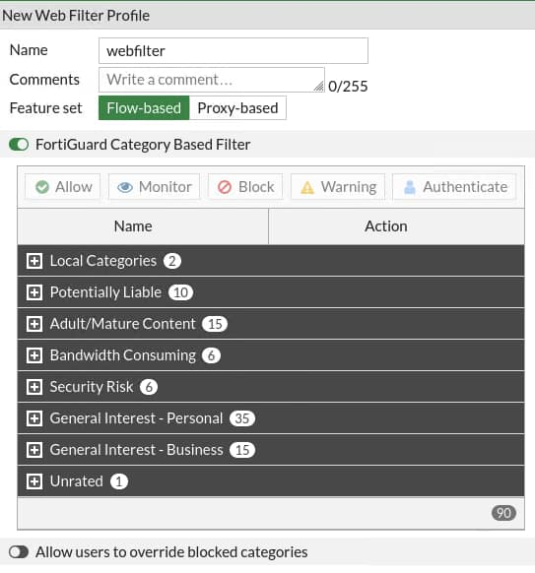
Web Filter Profiles—Flow Based
Profile based
  Configure web filter profile
    FortiGuard categories
    Static URL
    Rating option
  Apply profile to firewall policy
Policy based
  Apply application control and URL categories directly in a security policy
Policy & Objects > Security Policy
Security Profiles > Web Filter
Notes:
Now, you will look at the web filter profile.
You can configure this security profile to use a feature set for proxy-based or flow-based inspection modes. However, depending on the mode you select, the available settings are different. Flow-based inspection has fewer available options.
In the examples shown on this slide, the web filter profile has a FortiGuard category-based filter that categorizes the websites based on categories and subcategories by FortiGuard. FortiGate offers two NGFW options:
Profile-Based (default)
Web filters are defined as security profiles and applied to the firewall policy
Policy-Based
URL categories are defined directly under the firewall policy

Slide 14
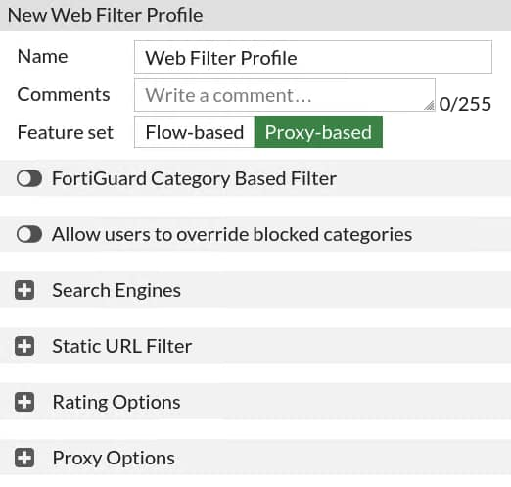
Web Filter Profiles—Proxy Based
Proxy-based options
  Configure web filter profile
    Local categories
    Remote categories
    Search engines
    Proxy options
Apply profile to firewall policy
  Proxy-based inspection mode type
Security Profiles > Web Filter
Notes:
In the example shown on this slide, the security profile is configured to use a proxy-based feature set. The profile is available to a firewall policy configured to use proxy-based inspection mode. Other local options include:
Search Engines
Static URL Filter
Rating Options
Proxy Options
After you configure your web filter profile, apply this profile to your firewall policy so the filtering is applied to your web traffic.

Slide 15
FortiGuard Category Filter
Split into multiple categories and subcategories
  Release new categories and subcategories compatible with updated firmware
  Older firmware has new values mapped to existing categories
Live connection to FortiGuard
  Active contract required
  Two-day grace period on expiry
Can use FortiManager instead of FortiGuard
Categories action:
Proxy-Based | Flow-Based (Profile) | Flow-Based (Policy)
Allow | Allow | Accept
Block | Block | Deny
Monitor | Monitor
Warning | Warning
Authenticate | Authenticate
Notes:
Rather than block or allow websites individually, FortiGuard category filtering looks at the category that a website has been rated with. Then, FortiGate takes action based on that category, not based on the URL.
FortiGuard category filtering is a live service that requires an active contract. The contract validates connections to the FortiGuard network. If the contract expires, there is a two-day grace period during which you can renew the contract before the service cuts off. If you do not renew, after the two-day grace period, FortiGate reports a rating error for every rating request made. In addition, by default, FortiGate blocks web pages that return a rating error. You can change this behavior by enabling the Allow websites when a rating error occurs setting. You will learn more about this setting in this lesson.
You can configure FortiManager to act as a local FortiGuard server. To do this, you must download the databases to FortiManager, and configure FortiGate to validate the categories against FortiManager, instead of FortiGuard.
You can enable the FortiGuard category filtering on the web filter. Categories and subcategories are listed, and you can customize the actions to perform individually.
The actions available depend on the mode of inspection:
Proxy: Allow, Block, Monitor, Warning, and Authenticate
Flow-based, profile-based: Allow, Block, Monitor, Warning, and Authenticate
Flow-based, policy-based: Action defined in a security policy (accept or deny)
To review the complete list of categories and subcategories, visit www.fortiguard.com/webfilter/categories.

Slide 16
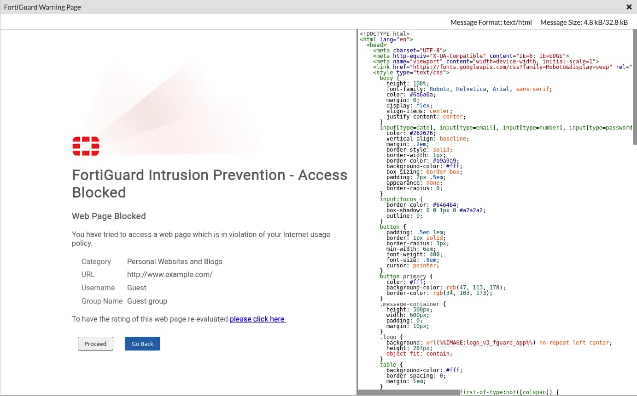
Web Filter FortiGuard Category Action—Warning
Category Action =
Exclusive for web filtering
  Proxy mode
  Flow mode (profile-based only)
  Not available in:
    Static URL filtering feature
FortiGuard warning page
  Customizable warning interval
System > Replacement Messages
Notes:
The warning action informs users that the requested website is not allowed by the internet policies. However, the action gives the user the option to proceed to the requested website, or return to the previous website.
You can customize the warning interval, so you can present this warning page at specific times, according to the configured period.

Slide 17
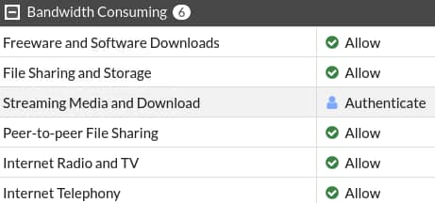



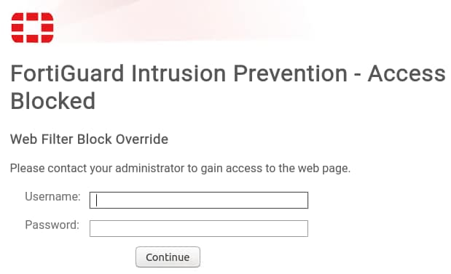
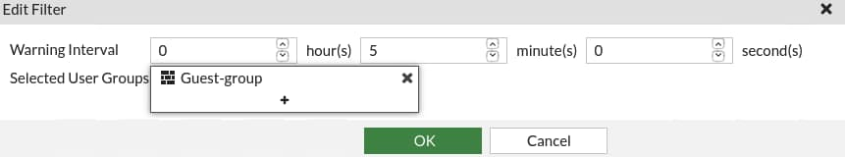

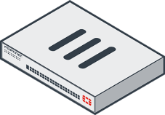



Web Filter FortiGuard Category Action—Authenticate
Security Profiles > Web Filter
WebFilter_Group
Define Users and Group
Set Action = Authenticate
Select User Group
www.youtube.com
Notes:
The authenticate action blocks the requested websites, unless the user enters a successful username and password. Local authentication and remote authentication using LDAP, radius and so on are supported for web filtering authentication.
You can customize the interval of time to allow access. Users are not prompted to authenticate again if they access other websites in the same category until the timer expires.
Choosing this action prompts you to define user groups that are allowed to override the block.

Slide 18
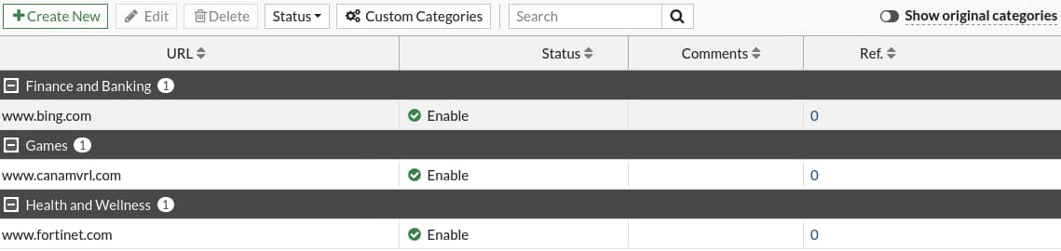
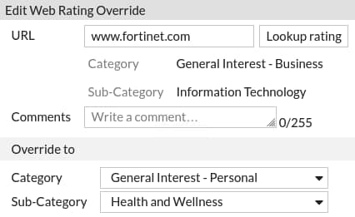
Web Rating Override—Configuration
Changes a website category, not the category action
  Make an exception
Security Profiles > Web Rating Overrides
Notes:
If you want to make an exception, for example, rather than unblock access to a potentially unwanted category, change the website to an allowed category. You can also do the reverse. You can block a website that belongs to an allowed category.
Remember that changing categories does not automatically result in a different action for the website. This depends on the settings within the web filter profile.

Slide 19
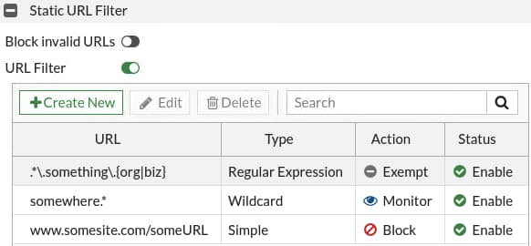




URL Filtering
Security Profiles > Web Filter
Check against configured URLs in URL filter
  Entries are checked from top to bottom
Four possible actions:
  Allow: Access is permitted. Traffic is passed to remaining operations, including FortiGuard web filter, web content filter, web script filters, and antivirus scanning.
  Block: Attempts are denied. User given a replacement message.
  Monitor: Traffic is allowed through. Log entries are created. Also subject to all other security profile inspections.
  Exempt: Allows traffic from trusted sources to bypass all security inspections.
Types of URL patterns:
  Simple, wildcards, or regular expressions
URL: www.somesite.com/someURL
Block
Notes:
Static URL filtering is another web filter feature. Configured URLs in the URL filter are checked against the visited websites. If a match is found, the configured action is taken. URL filtering has the same patterns as static domain filtering: simple, regular expressions, and wildcard.
Take a look at how it works.
When a user visits a website, FortiGate looks at the URL list for a matching entry. In the example shown on this slide, the website matches the third entry in the table, which is set as type Simple. This type means that the match must be exact—there is no option for a partial match with this pattern. Also, the action is set to Block, so FortiGate displays a block page message.

Slide 20
Which of the following can act as a local FortiGuard server?
  FortiManager
  FortiAnalyzer
Which action in URL filtering will bypass all security profiles?
  Exempt
  Allow

Slide 21
Inspection Modes
Web Filtering Basics
Additional Proxy-Based Web Filtering Features
Video Filtering
Best Practices and Troubleshooting
Notes:
Good job! You now understand the basics of web filtering.
Now, you will learn about additional proxy-based web filtering features.

Slide 22
Additional Proxy-Based Web Filtering Features
Configure web filter to support search engines
Configure web content filtering
Notes:
After completing this section, you should be able to achieve the objectives shown on this slide.
By demonstrating competence in additional proxy-based web filtering features, you will be able to search engine filters, and web content filtering.

Slide 23
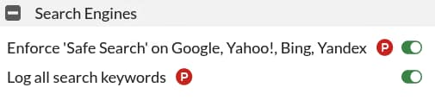
Search Engine Filtering
A proxy-based mode feature
Requires FortiGate to use deep SSL inspection
  Not supported when using certificate inspection
  FortiGate requires full access to the application layer data
Restricts websites or images from search results
  Rewrites the search URL to enable safe search
    For Google, Yahoo, Bing, and Yandex
Logs all search keywords
Security Profiles > Web Filter
config webfilter profile
edit "default"
config web
set safe-search url header
end
next
end
Notes:
Search engine filtering is available when you configure a web filter profile while setting the feature set to proxy-based.
Safe search is an option that some browsers support. It applies internal filters to the search results. When you enable safe search for the supported search sites, FortiGate appends code to the URL to enforce the use of safe search. For example, on a Google search, FortiGate adds the string &safe=active to the URL in the search. So, even if it is not locally enabled in the browser, FortiGate applies safe search to the requests when they pass through. Safe search is supported for Google, Yahoo, Bing, and Yandex.
As a proxy-based web filter feature, search engine filtering is supported only when using full SSL inspection because FortiGate requires access to the full header.

Slide 24
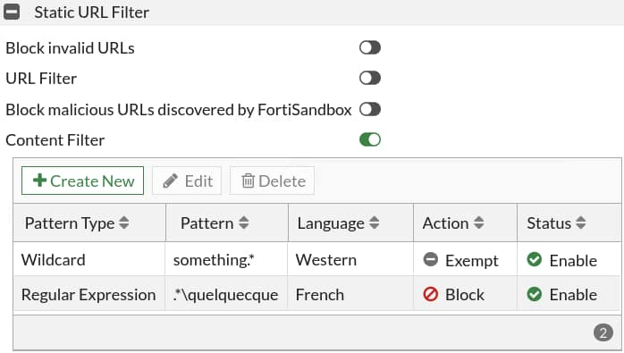
Web Content Filtering
Requires FortiGate to use SSL deep inspection
Controls access to web pages containing specific patterns
Scans the content of every website accepted by security policies
Matches content from wildcards or Perl regular expressions
The maximum number of web content patterns in a list is 5000
Actions:
  Exempt
  Block
Security Profiles > Web Filter
Notes:
You can also control web content in the web filter profile by blocking access to websites containing specific words or patterns. This helps to prevent access to sites with questionable material.
You can add words, phrases, patterns, wildcards, and Perl regular expressions to match content on websites. You configure this feature on a per-web-filter-profile basis, not at the global level. So, it is possible to add multiple web content filter lists and then select the best list for each web filter profile.
The system administrator can specify banned words and phrases and attach a numerical value, or score, to the importance of those words and phrases. When the web content filter scan detects banned content, it adds the scores of banned words and phrases on the page. If the sum is higher than the threshold set in the web filter profile, FortiGate blocks the site.
The maximum number of web content patterns in a list is 5000.
Like search engine filtering, web content filtering requires that FortiGate uses deep SSL inspection because FortiGate requires full access to the packet headers.

Slide 25
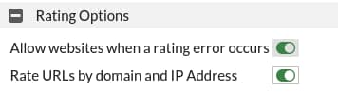
Advanced Web Filter Settings
Rating options:
1
Allow access to websites that return a rating error from the FortiGuard Web Filter service
Security Profiles > Web Filter
2
Add additional security. The URL and IP address are rated separately.
Notes:
You can use advanced web filtering settings to improve the web filter.
The rating options are as follows:
Allow websites when a rating error occurs. If a rating error occurs from the FortiGuard web filter service, users have full unfiltered access to all websites.
Rate URLs by domain and IP Address. This option sends both the URL and the IP address of the requested site for checking, providing additional security against attempts to bypass the FortiGuard system.

Slide 26
Which of the following is used for matching content in Web Content Filtering ?
  Perl regular expressions
  Boolean operators
Which feature can be used for restricting websites or images from search results ?
  Web Content Filtering
  Search Engine Filtering

Slide 27
Inspection Modes
Web Filtering Basics
Additional Proxy-Based Web Filtering Features
Video Filtering
Best Practices and Troubleshooting
Notes:
Good job! You now understand additional proxy-based web filtering features.
Now, you will learn about video filtering.

Slide 28
Video Filtering
Enable a YouTube API key
Filter YouTube videos using FortiGuard
Filter YouTube based on restriction level
Filter YouTube channels
Notes:
After completing this section, you should be able to achieve the objectives shown on this slide.
By demonstrating competence in video filtering, you will be able to control access to YouTube using FortiGuard categories and YouTube static IDs.

Slide 29


Video Filter Profile
Controls YouTube content access:
  To allow, monitor, or block based on category
  To allow, monitor, or block access to channels
  To set restriction levels
Separate FortiGuard license for video filtering
Supported only on proxy-based firewall policy
Requires full SSL inspection
Requires YouTube API key
Enables YouTube key on CLI
  You can add multiple YouTube API keys
Filters videos using two methods:
  FortiGuard categories
  Channel IDs
Notes:
Video filtering allows you to control access to YouTube content using parameters that are associated with the video channel, video categories, or the video itself. It is part of the FortiGuard service, which requires a separate license bundled with the other FortiGuard security services.
To apply the video filter profile, proxy-based firewall polices currently allow you to enable the video filter profile. You must enable full SSL inspection on the firewall policy.
You must obtain a YouTube API key to use the video filter feature. The API key allows FortiGate to match parameters identified when users access YouTube content, and match the parameters with the local categories defined on the video filter.

Slide 30
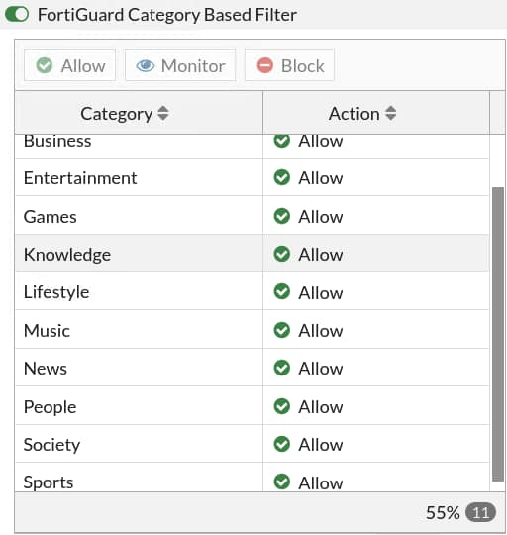
Video Filter Profile—FortiGuard Categories
Set the action to allow, monitor, or block videos based on FortiGuard category
FortiGuard categories for video filtering are based on universal classification:
  Combine popular online video provider categories
FortiGuard video categories:
  Applicable to videos from YouTube, Vimeo, Dailymotion
  Require API to determine category and match it on the video filter
  Security action determines the flow of security checks:
    If set to allow, bypass the rest of video filter profile
    If set to monitor, log access and continue
    If block, log and prevent playing the video
Security Profiles > Video Filter
11 local universal categories available to match with API determined value when accessing the content
Notes:
The video filter can identify videos using universal categories used by major online video content providers, such as YouTube. The generic classification combines multiple categories by these providers into one category. For example, the FortiGuard video category Entertainment includes YouTube categories, such as entertainment, comedy, movies, shows, and trailers.
The FortiGuard video categories are universal, to cover the common classifications used in the categories of online video content providers. Currently, it is applicable to content hosted by YouTube, Vimeo, and Dailymotion. Some of these providers offer API queries that enable FortiGate to identify the content and match it to local FortiGuard video categories.
In a video filter profile, if a FortiGuard category is allowed, the video content bypasses the rest of the security checks configured on the video profile, such as channel override and YouTube restriction level. If the action is set to monitor or block, then the video content undergoes further security checks configured on the video filter profile.

Slide 31
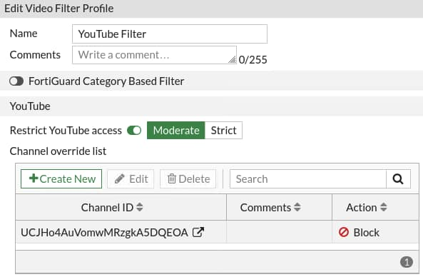
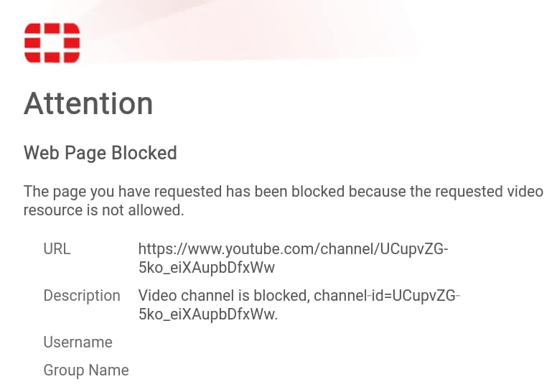
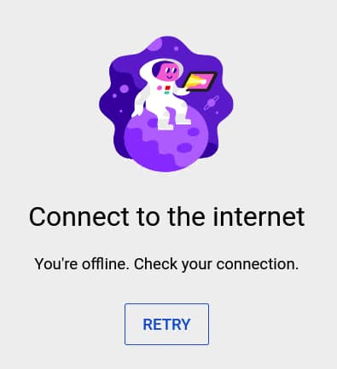
Video Filter Profile—YouTube
Set Moderate or Strict access to YouTube
You can Allow, Monitor, or Block access to specific YouTube channels IDs
Security Profiles > Video Filter
Accessing the channel while on YouTube is blocked as configured in the video filter profile
You will see a replacement message if you access a blocked channel directly using the URL
Notes:
You can restrict YouTube access on a video filter by setting the restriction level to Moderate or Strict. When users access YouTube content using the firewall policy with the video filter profile applied, the users are given only content that is screened according to a filter applied by Google. Moderate restricted access is similar to strict but makes more videos available.
The YouTube channel ID is used to identify YouTube channels. It allows FortiGate to apply actions to access related content on the channel. These actions can allow, monitor, or block access to the channel. If a video filter has a channel override to block a specific YouTube channel, access to this channel is stopped only to this particular channel. If a user attempts to access the channel while surfing YouTube content, an error message appears telling the user that they must connect to the internet. If the user accesses the channel using the URL, a blocked replacement message shows up to confirm the reason why access is blocked.

Slide 32
Which is required by FortiGate to configure YouTube video filtering?
  YouTube API key
  Username
Which action in video filtering will prevent the videos from playing?
  Deny
  Block

Slide 33
Inspection Modes
Web Filtering Basics
Additional Proxy-Based Web Filtering Features
Video Filtering
Best Practices and Troubleshooting
Notes:
Good job! You now understand the video filtering feature.
Now, you will learn about best practices and troubleshooting.

Slide 34
Best Practices and Troubleshooting
Understand HTTP inspection order
Troubleshoot filter issues
Investigate FortiGuard connection issues
Apply web filter cache best practices
Monitor logs for web filtering events
Notes:
After completing this section, you should be able to achieve the objectives shown on this slide.
By demonstrating competence in best practices and troubleshooting, you will be able to apply various best practices and troubleshooting techniques to avoid and investigate common issues.

Slide 35
HTTP Inspection Order
EXEMPT
(from ALL further inspection)
Exempt
Static URL Filter
FortiGuard Category Filter
Advanced Filters
URL
Display Page
Allowed
Allowed
Allowed
Block
Block
Block
Block Page
Block Page
Block Page
Notes:
Remember that the web filtering profile has several features. So, if you have enabled many of them, the inspection order flows as follows:
The local static URL filter
FortiGuard category filtering (to determine a rating)
Advanced filters (such as safe search or removing Active X components)
For each step, if there is no match, FortiGate moves on to the next check enabled.

Slide 36
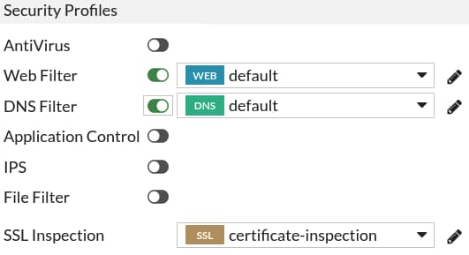
Apply the Filters
It’s not working. Why?
  Did you apply the security profiles to the firewall policies?
  Did you apply the SSL inspection profile, if needed?
config firewall policy
edit 1
set webfilter-profile <profile>
next
end
config firewall profile-group
edit <group name>
set webfilter-profile <profile>
next
end
Policy & Objects > Firewall Policy
Notes:
You have configured your security profiles, but they are not performing web inspection. Why?
Check to see if you have applied the security profiles to your firewall policies. Also, make sure that the SSL inspection profile is applied as needed.

Slide 37
FortiGuard Connection
FortiGuard category filtering requires a live connection
Weight Calculation: default = (difference in time zone) x 10
  Goes down over time (never below default)
  Goes up if FortiGuard requests are lost
FortiGate-VM64 # diagnose debug rating
Locale : english
Service : Web-filter
Status : Enable
License : Contract
\
Num. of servers : 1
Protocol : https
Port : 443
Anycast : Enable
Default servers : Included
-=- Server List (Wed Apr 21 13:59:43 2021) -=-
IP Weight RTT Flags TZ FortiGuard-requests Curr Lost Total Lost Updated Time
173.243.140.16 -72 101 DI 0 36 0 0 Wed Apr 21 13:58:13 2021
Notes:
Category-based filtering requires a live connection to FortiGuard.
You can verify the connection to FortiGuard servers by running the diagnose debug rating CLI command. This command displays a list of FortiGuard servers you can connect to, as well as the following information:
Weight: Based on the difference in time zone between FortiGate and this server (modified by traffic)
RTT: Return trip time
Flags: D (IP returned from DNS), I (Contract server contacted), T (being timed), F (failed)
TZ: Server time zone
FortiGuard-requests: The number of requests sent by FortiGate to FortiGuard
Curr Lost: Current number of consecutive lost FortiGuard requests (in a row, resets to 0 when one packet succeeds)
Total Lost: Total number of lost FortiGuard requests
The list is of variable length depending on the FortiGuard Distribution Network.

Slide 38
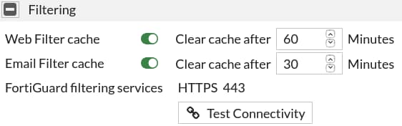
Web Filter Cache
Improves performance by reducing requests to FortiGuard
Cache is checked before sending a request to the FortiGuard server
  FortiGate remembers response of visited websites
  TTL settings control the number of seconds the query results are cached
  Request is considered a rating error after timeout (15 seconds as default)
HTTPS port 443 enforced by default FortiGuard or FortiManager communications
  Disable FortiGuard anycast setting on CLI to use UDP ports 443, 53, or 8888
Enabled by default—default TTL is 60 minutes (3600 seconds)
System > FortiGuard
config system fortiguard
set fortiguard-anycast {enable|disable}
set protocol {udp|https}
set port {8888|53|443}
set webfilter-timeout {<1> - <30>}
end
Notes:
FortiGate can maintain a list of recent website rating responses in memory. So, if the URL is already known, FortiGate doesn’t send back a rating request.
By default, FortiGate is configured to enforce the use of HTTPS port 443 to perform live filtering with FortiGuard or FortiManager. Other ports and protocols are available by disabling the FortiGuard anycast setting on the CLI. These ports and protocols to query the servers (FortiGuard or FortiManager) HTTPS port 53 and port 8888, UDP port 443, port 53, and port 8888. If you are using UDP port 53, any kind of inspection reveals that this traffic is not DNS and prevents the service from working. In this case, you can switch to the alternate UDP port 443 or port 8888, or change the protocol to HTTPS, but these ports are not guaranteed to be open in all networks, so you must check beforehand.
Caching responses reduces the amount of time it takes to establish a rating for a website. Also, memory lookup is much quicker than packets travelling on the internet.
The timeout defaults to 15 seconds, but you can set it as high as 30 seconds, if necessary.

Slide 39
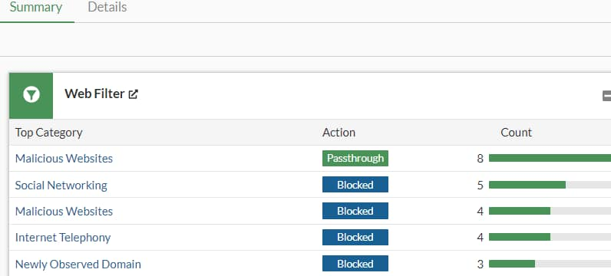
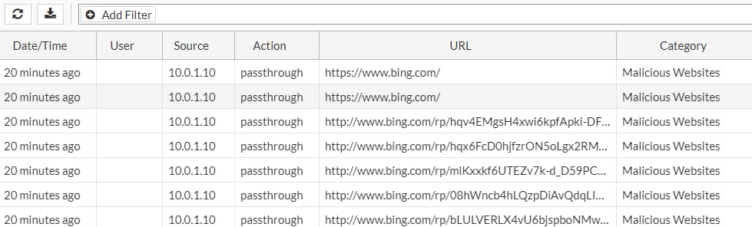
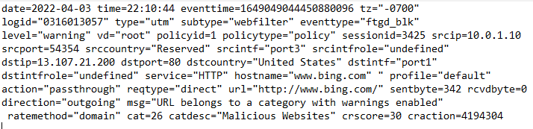
Web Filter Log
Record HTTP traffic activity, such as:
  Action, profile used, category, URL, quota info, and so on
Log & Report > Security Events
Notes:
Now, take a look at the web filter log and report feature.
This slide shows an example of a log message. Access details include information about the FortiGuard quota and category (if those are enabled), which web filter profile was used to inspect the traffic, the URL, and more details about the event.
You can also view the raw log data by clicking the download icon at the top of the GUI. The file downloaded is a plain text file in a syslog format.

Slide 40
You have configured your security profiles, but they are not performing web or DNS inspection. Why?
  The certificate is not installed correctly.
  The profile is not associated with the correct firewall policy.

Slide 41
Inspection Modes
Web Filtering Basics
Additional Proxy-Based Web Filtering Features
Video Filtering
Best Practices and Troubleshooting
Notes:
Congratulations! You have completed this lesson.
Now, you will review the objectives that you covered in the lesson.

Slide 42
Describe FortiOS inspection modes
Implement NGFW operation modes
Work with web filter categories
Configure web filter to support search engines
Apply video filter on proxy-based firewall policy
Monitor logs for web filtering events
Notes:
This slide shows the objectives that you covered in this lesson.
By mastering the objectives covered in this lesson, you learned how to configure web filtering on FortiGate to control web traffic in your network.

